Slide 2
Absence of Copyright
This slideshow contains photos, diagrams, and information, some of which were attained through internet searches of public websites. The author of this presentation does not own the copyright on this information, so this slideshow is for personal use only—not for sale or profit. Please utilize it to seek the Lord and grow in your knowledge of His Word and ways.

Slide 4
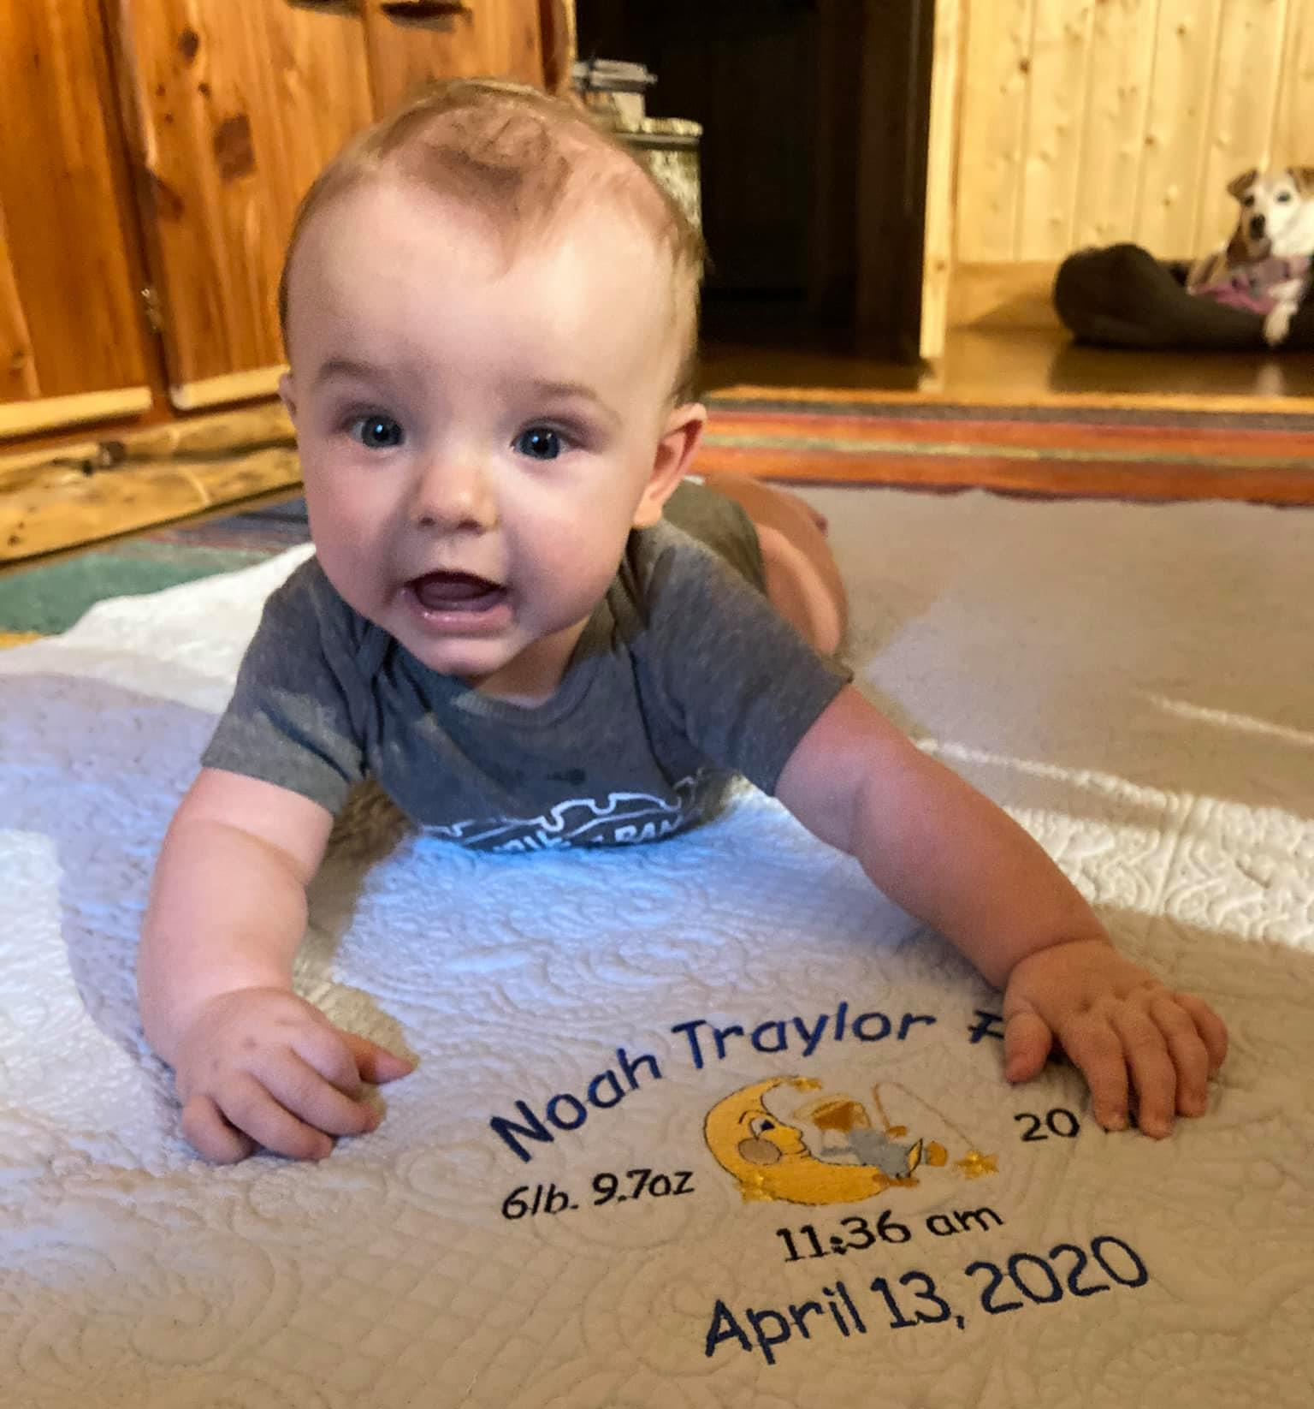
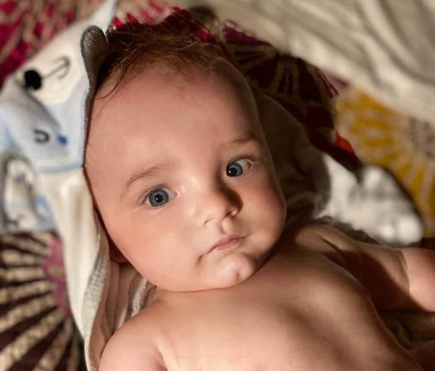
Double dose of Noah tonight!

Slide 5
Prayer and Announcements
Sunday: 9:15 Fellowship
9:30 SS Master Class
10:30 Worship
Revelation Study available on our church website
www.faithprinceton.org
Email questions and comments to
pastor@faithprinceton.org

Slide 7
END HERE SEPTEMBER 2, 2020
LAST WEEK 16 Revelation 11
The Last Trumpet
BEGIN HERE SEPTEMBER 9, 2020
WEEK 17 Revelation 12

Slide 8
Revelation 11
Measuring the Temple
The Two Witnesses
The Last Trumpet
The Rise of the Beast

Slide 9
Revelation 11:15ff The Last Trumpet...
15 Then the seventh angel blew his trumpet, and there were loud voices in heaven, saying, “The kingdom of the world has become the kingdom of our Lord and of his Christ, and he shall reign forever and ever.” 16 And the twenty-four elders who sit on their thrones before God fell on their faces and worshiped God, 17 saying,
Notes:
Meanwhile... Back in heaven... Still worship!!!
THE LAST TRUMPET the woe of the seventh trumpet won’t come until the bowl judgments in chapter 16!!!
Revelation 8:2 And I saw the seven angels who stand before God, and seven trumpets were given to them. = Referred to as “the Trumpet Judgments”
? Same as the last trumpet in 1 Corinthians 15:51-52 (see also 1 Thess 4)???
The Seventh Trumpet Revelation 11:15ff. Central idea of Revelation: the establishment of the Kingdom of God!!!

Slide 10
Revelation 11:15ff The Last Trumpet
17 saying,
“We give thanks to you, Lord God Almighty, who is and who was, for you have taken your great power and begun to reign. 18 The nations raged, but your wrath came, and the time for the dead to be judged, and for rewarding your servants, the prophets and saints, and those who fear your name, both small and great, and for destroying the destroyers of the earth.”
Notes:
THE LAST TRUMPET FRQUENTLY IN NT
➔

Slide 11
Matthew 24:29-31 The Last Trumpet
29 “But immediately after the tribulation of those days the sun will be darkened, and the moon will not give its light, and the stars will fall from the sky, and the powers of the heavens will be shaken. 30 And then the sign of the Son of Man will appear in the sky, and then all the tribes of the earth will mourn, and they will see the Son of Man coming on the clouds of the sky with power and great glory. 31 And He will send forth His angels with a great trumpet and they will gather together His elect from the four winds, from one end of the sky to the other.
Notes:
THE LAST TRUMPET FRQUENTLY IN NT
Matthew 24:29-31 ²⁹ “But immediately after the tribulation of those days the sun will be darkened, and the moon will not give its light, and the stars will fall from the sky, and the powers of the heavens will be shaken. ³⁰ And then the sign of the Son of Man will appear in the sky, and then all the tribes of the earth will mourn, and they will see the Son of Man coming on the clouds of the sky with power and great glory. ³¹ And He will send forth His angels with a great trumpet and they will gather together His elect from the four winds, from one end of the sky to the other.
1 Corinthians 15:51-52 ESV
Behold! I tell you a mystery. We shall not all sleep, but we shall all be changed, in a moment, in the twinkling of an eye, at the last trumpet. For the trumpet will sound, and the dead will be raised imperishable, and we shall be changed.
1 Thessalonians 4:13-18 ESV
But we do not want you to be uninformed, brothers, about those who are asleep, that you may not grieve as others do who have no hope. For since we believe that Jesus died and rose again, even so, through Jesus, God will bring with him those who have fallen asleep. For this we declare to you by a word from the Lord, that we who are alive, who are left until the coming of the Lord, will not precede those who have fallen asleep. For the Lord himself will descend from heaven with a cry of command, with the voice of an archangel, and with the sound of the trumpet of God. And the dead in Christ will rise first. Then we who are alive, who are left, will be caught up together with them in the clouds to meet the Lord in the air, and so we will always be with the Lord. ...
The Seventh Trumpet Revelation 11:15ff.
¹⁵ Then the seventh angel blew his trumpet, and there were loud voices in heaven, saying, “The kingdom of the world has become the kingdom of our Lord and of his Christ, and he shall reign forever and ever.” ¹⁶ And the twenty-four elders who sit on their thrones before God fell on their faces and worshiped God, ¹⁷ saying,
“We give thanks to you, Lord God Almighty, who is and who was, for you have taken your great power and begun to reign. ¹⁸ The nations raged, but your wrath came, and the time for the dead to be judged, and for rewarding your servants, the prophets and saints, and those who fear your name, both small and great, and for destroying the destroyers of the earth.”
¹⁹ Then God's temple in heaven was opened, and the ark of his covenant was seen within his temple. There were flashes of lightning, rumblings, peals of thunder, an earthquake, and heavy hail.

Slide 12
1 Corinthians 15:51-52 The Last Trumpet
51 Behold! I tell you a mystery. We shall not all sleep, but we shall all be changed, in a moment, in the twinkling of an eye, at the last trumpet. 52 For the trumpet will sound, and the dead will be raised imperishable, and we shall be changed.
Notes:
Matthew 24:29-31 ²⁹ “But immediately after the tribulation of those days the sun will be darkened, and the moon will not give its light, and the stars will fall from the sky, and the powers of the heavens will be shaken. ³⁰ And then the sign of the Son of Man will appear in the sky, and then all the tribes of the earth will mourn, and they will see the Son of Man coming on the clouds of the sky with power and great glory. ³¹ And He will send forth His angels with a great trumpet and they will gather together His elect from the four winds, from one end of the sky to the other.
1 Corinthians 15:51-52 ESV
Behold! I tell you a mystery. We shall not all sleep, but we shall all be changed, in a moment, in the twinkling of an eye, at the last trumpet. For the trumpet will sound, and the dead will be raised imperishable, and we shall be changed.
1 Thessalonians 4:13-18 ESV
But we do not want you to be uninformed, brothers, about those who are asleep, that you may not grieve as others do who have no hope. For since we believe that Jesus died and rose again, even so, through Jesus, God will bring with him those who have fallen asleep. For this we declare to you by a word from the Lord, that we who are alive, who are left until the coming of the Lord, will not precede those who have fallen asleep. For the Lord himself will descend from heaven with a cry of command, with the voice of an archangel, and with the sound of the trumpet of God. And the dead in Christ will rise first. Then we who are alive, who are left, will be caught up together with them in the clouds to meet the Lord in the air, and so we will always be with the Lord. ...
The Seventh Trumpet Revelation 11:15ff.
¹⁵ Then the seventh angel blew his trumpet, and there were loud voices in heaven, saying, “The kingdom of the world has become the kingdom of our Lord and of his Christ, and he shall reign forever and ever.” ¹⁶ And the twenty-four elders who sit on their thrones before God fell on their faces and worshiped God, ¹⁷ saying,
“We give thanks to you, Lord God Almighty, who is and who was, for you have taken your great power and begun to reign. ¹⁸ The nations raged, but your wrath came, and the time for the dead to be judged, and for rewarding your servants, the prophets and saints, and those who fear your name, both small and great, and for destroying the destroyers of the earth.”
¹⁹ Then God's temple in heaven was opened, and the ark of his covenant was seen within his temple. There were flashes of lightning, rumblings, peals of thunder, an earthquake, and heavy hail.

Slide 13
1 Thessalonians 4:13-18 The Last Trumpet.
But we do not want you to be uninformed, brothers, about those who are asleep, that you may not grieve as others do who have no hope. For since we believe that Jesus died and rose again, even so, through Jesus, God will bring with him those who have fallen asleep. For this we declare to you by a word from the Lord, that we who are alive, who are left until the coming of the Lord, will not precede those who have fallen asleep. For the Lord himself will descend from heaven with a cry of command, with the voice of an archangel, and with the sound of the trumpet of God. And the dead in Christ will rise first. Then we who are alive, who are left, will be caught up together with them in the clouds to meet the Lord in the air, and so we will always be with the Lord. ...
Notes:
Matthew 24:29-31 ²⁹ “But immediately after the tribulation of those days the sun will be darkened, and the moon will not give its light, and the stars will fall from the sky, and the powers of the heavens will be shaken. ³⁰ And then the sign of the Son of Man will appear in the sky, and then all the tribes of the earth will mourn, and they will see the Son of Man coming on the clouds of the sky with power and great glory. ³¹ And He will send forth His angels with a great trumpet and they will gather together His elect from the four winds, from one end of the sky to the other.
1 Corinthians 15:51-52 ESV
Behold! I tell you a mystery. We shall not all sleep, but we shall all be changed, in a moment, in the twinkling of an eye, at the last trumpet. For the trumpet will sound, and the dead will be raised imperishable, and we shall be changed.
1 Thessalonians 4:13-18 ESV
But we do not want you to be uninformed, brothers, about those who are asleep, that you may not grieve as others do who have no hope. For since we believe that Jesus died and rose again, even so, through Jesus, God will bring with him those who have fallen asleep. For this we declare to you by a word from the Lord, that we who are alive, who are left until the coming of the Lord, will not precede those who have fallen asleep. For the Lord himself will descend from heaven with a cry of command, with the voice of an archangel, and with the sound of the trumpet of God. And the dead in Christ will rise first. Then we who are alive, who are left, will be caught up together with them in the clouds to meet the Lord in the air, and so we will always be with the Lord. ...
The Seventh Trumpet Revelation 11:15ff.
¹⁵ Then the seventh angel blew his trumpet, and there were loud voices in heaven, saying, “The kingdom of the world has become the kingdom of our Lord and of his Christ, and he shall reign forever and ever.” ¹⁶ And the twenty-four elders who sit on their thrones before God fell on their faces and worshiped God, ¹⁷ saying,
“We give thanks to you, Lord God Almighty, who is and who was, for you have taken your great power and begun to reign. ¹⁸ The nations raged, but your wrath came, and the time for the dead to be judged, and for rewarding your servants, the prophets and saints, and those who fear your name, both small and great, and for destroying the destroyers of the earth.”
¹⁹ Then God's temple in heaven was opened, and the ark of his covenant was seen within his temple. There were flashes of lightning, rumblings, peals of thunder, an earthquake, and heavy hail.

Slide 14
Revelation 11:19
19 And the temple of God which is in heaven was opened; and the ark of His covenant appeared in His temple, and there were flashes of lightning and sounds and peals of thunder and an earthquake and a great hailstorm.
Notes:
Meanwhile... Back in heaven... Still worship!!!
Opening up of God’s presence!!!
No one was able to see the ark of His Covenant, (except the High Priest one day a year) and it had been missing since the Babylonian captivity
Now John has a clear view of it
☺ ➔ Indiana Jones stored it in a government warehouse in D.C.

Slide 15
Revelation 12 Another Interlude
The Woman, The Child, and the Dragon
Notes:
Foretelling the Future?
Re-telling the Past?
Literal or Symbolic?
Salvation History?
*** READ ALL OF CHAPTER 12
https://lifehopeandtruth.com/prophecy/revelation/revelation-12/
Who Are the Woman, Child and Dragon in Revelation 12?
by David Treybig
The book of Revelation is a vision from Jesus Christ, given to Him by God the Father, which reveals what is going to happen before His return to establish the Kingdom of God on earth. This fascinating book is also called the Apocalypse, from the Greek word that means revelation. This prophetic book is primarily written in a chronological style with occasional breaks for overviews of specific subjects.
Revelation 12 is one of these overviews, providing a history stretching from the time before humans existed until the time just before Christ’s return as King of Kings and Lord of Lords.
Revelation 12 begins with the statement: “Now a great sign appeared in heaven” (verse 1). The word “sign” comes from the Greek word semeion, meaning “a sign, mark, token … an unusual occurrence, transcending the common course of nature” (Thayer’s Greek Definitions). The first great sign is a vision of a woman who gave birth to a child (verse 1).
Then in verse 3 we read, “And another sign [semeion] appeared in heaven.” We thus understand that these three symbols—a woman, a child and a dragon—represent things beyond the ordinary events of nature. As we are going to see, these three figures symbolize three major spiritual forces that have been at work for several thousand years.
In order to understand this chapter, we now need to understand the symbols. What do the woman, the Child and the dragon represent?
Who is the woman in Revelation 12?
The woman of the Apocalypse—described as being “clothed with the sun, with the moon under her feet, and on her head a garland of twelve stars” (verse 1)—represents Old Testament Israel. In the Old Testament, God referred to His people as a woman whom He had dressed in honor and splendor (Ezekiel 16). The garland with 12 stars may be symbolic of the 12 tribes of Israel (Genesis 37:9-10).
Throughout Revelation 12 we note that the “woman” is repeatedly protected by God (verses 6, 14-16), especially as the time approaches for the “kingdom of our God” to be established on earth (verse 10).
In the New Testament, God’s Church is symbolized as a woman; and its members are likened to virgins (Matthew 25:1-13; Revelation 14:4; Revelation 19:7). The New Testament Church is called “the Israel of God” (Galatians 6:16) and likened to “Jerusalem above,” which is called “the mother of us all” (Galatians 4:26, also see Hebrews 12:22-23). Members of the Church are described as “a chosen generation, a royal priesthood, a holy nation, His [God’s] own special people” (1 Peter 2:9).
When Christ returns to earth, He is going to marry the Church, which is called “His wife” in Revelation 19:7. Read more about Jesus Christ and the Church in our article “Marriage Supper of the Lamb.” Based on these passages, it is clear that the woman in Revelation 12 represents God’s people.
Incidentally, it is also interesting to note that the imagery of a dishonorable woman—one called “the great harlot”—is used in Revelation 17:1 to depict a false church that deceives many. Read more about this in our article “Mystery, Babylon the Great.”
Who is the Child in Revelation 12?
The woman (God’s chosen nation of Israel) is described as giving birth to a “male Child who was to rule all nations with a rod of iron” (Revelation 12:5). Indeed, Jesus Christ was born into this nation. The verse continues, “And her Child was caught up to God and His throne.” The language here makes it clear that Jesus is the “Child” in Revelation 12.
Jesus is the One who is prophesied to “strike the nations. And He Himself will rule them with a rod of iron” (Revelation 19:15). He is also the One who, after His resurrection, was taken up in a cloud to heaven (Acts 1:9-11).
Who is the dragon?
The third symbol of Revelation 12—“a great, fiery red dragon” (verse 3)—is described as having drawn “a third of the stars of heaven” and standing “before the woman who was ready to give birth, to devour her Child as soon as it was born” (verse 4). A few verses later, this dragon is clearly identified as Satan: “So the great dragon was cast out, that serpent of old, called the Devil and Satan, who deceives the whole world” (verse 9).
As for the dragon drawing “a third of the stars of heaven,” this reference apparently represents Satan leading a third of the angels in a rebellion against God. Other passages show stars represent angels (Revelation 1:20).
The Bible also explains that Satan had been involved in a rebellion against God in which he attempted to exalt his “throne above the stars of God” and “be like the Most High” (Isaiah 14:13-14). Satan then began his work as “that serpent of old [the one who tempted Eve in the Garden of Eden], called the Devil and Satan, who deceives the whole world” (Revelation 12:9, emphasis added throughout). For a more extensive explanation of Satan’s rebellion, see “God vs. Satan.”
If God has “ministers of righteousness,” Satan also has his servants—physical ministers (themselves deceived and helping deceive others) and spirit beings who pass themselves off as righteous but incite human beings to sin (2 Corinthians 11:15; Ephesians 6:12). Jude further describes the fallen angels or demons as “angels who did not keep their proper domain” and who are now “reserved in everlasting chains under darkness for the judgment of the great day” (Jude 1:6).
Revelation 12:3-17 is a concise history of Satan’s efforts to thwart God’s plan to bring many humans to glory as part of His eternal family. Satan’s actions included convincing a third of the angels to follow him in his attempt to make himself like God, attempting to have Christ killed as a child (Matthew 2:13-18), working to deceive the entire world and persecuting God’s people. Let’s now consider in greater detail Satan’s attempts to derail God’s plan.
The dragon vs. the Child
In Revelation 12:4 we read that “the dragon stood before the woman who was ready to give birth, to devour her Child as soon as it was born.” This appears to be a historical reference to King Herod’s effort to destroy Jesus as a young child by ordering the deaths of all male children from two years old and under who lived in and around Bethlehem (Matthew 2:13-18). But an angel had warned Joseph to flee to Egypt with his wife and Jesus to keep the Child from being destroyed (verse 13).
The Believer’s Bible Commentary notes this about Revelation 12:4-5: “The dragon is ready to devour the Child as soon as He is born—fulfilled in the attempt of Herod the Great, vassal of Rome, to destroy the newborn King of the Jews. The male Child is clearly Jesus, destined to rule all the nations with a rod of iron.”
Even though Satan’s attempt to destroy Jesus when He was a child failed, the devil did not give up. Prior to the beginning of Jesus’ ministry, “Jesus was led up by the Spirit into the wilderness to be tempted by the devil” (Matthew 4:1). During this temptation, Satan tried to get Jesus to violate God’s law and worship him instead of God. The devil offered Jesus “all the kingdoms of the world and their glory” (verse 8) if Jesus would worship him. But Jesus did not do so.
When Jesus’ ministry was fulfilled and it was time for Him to give His life as payment for humanity’s sins, Satan was there once again. On this occasion, Satan was the one who “put it into the heart of Judas Iscariot, Simon’s son, to betray Him” (John 13:2). Although Satan was clearly involved in the crucifixion of Jesus, this was actually part of God’s plan for the redemption of mankind.
As Genesis 3:15 had predicted, there would be ongoing “enmity” between the serpent (Satan) and the woman (God’s people) and the “Seed” (Jesus) who would come from the woman. Furthermore, this passage indicated that Satan would have limited success in being able to “bruise” Christ’s heel by influencing the man who would betray Jesus and that Jesus would “bruise” Satan’s head by resisting his temptations and qualifying to replace him as the ruler of this world.
So why did Satan expend so much effort in his attempts to destroy Jesus? Because if there had not been a perfect Savior to pay the penalty for humanity’s sins, God’s plan would have been thwarted. Without a Savior, humans could not be forgiven of their sins nor could they live forever in God’s eternal family.
The dragon vs. God’s people
In addition to his efforts to destroy Jesus, Satan has a long history of persecuting God’s people, especially members of God’s Church, represented by the woman in the latter portions of Revelation 12. Although there was fierce persecution from the earliest days of the New Testament Church, God allowed the woman to flee “into the wilderness, where she has a place prepared by God, that they should feed her there one thousand two hundred and sixty days” (verse 6).
This verse indicates that the true Church was protected by God for 1,260 years (see Numbers 14:34 and Ezekiel 4:6, showing that a day can represent a year). During this time—which may have continued through the Middle Ages—the Church was protected from its enemies, including the Roman Empire and false Christianity.
The next two verses then explain that “war broke out in heaven” between Satan and his angels and Michael and his angels. As a result of this war, John, in vision, saw that a place for Satan and his angels was not “found for them in heaven any longer” and they were “cast to the earth” (Revelation 12:7-9). This battle is different from Satan’s original rebellion, which is described in verse 4 and which occurred long before the birth of Christ.
The setting for this battle, described in verses 7-9, and its significance is then announced by a loud voice in heaven (verses 10-12). This battle is an indicator that “the kingdom of our God, and the power of His Christ have [or will soon] come” (verse 10). Prior to this event, Satan has had access to God’s presence to accuse His people (Job 1:6-7; Job 2:1-2). Now he and his angels no longer have this access and are cast down to the earth.
Realizing the significance of this event, Satan the dragon now has “great wrath, because he knows that he has a short time” (Revelation 12:12) before Christ returns to establish the Kingdom of God on earth. He then directs his rage toward God’s people, the ones who are the continuation of the woman of the Apocalypse who gave birth to the male Child (verse 13).
God, however, will not allow Satan to destroy His people. Jesus had promised that the “gates of Hades [the grave]” would not prevail against it (Matthew 16:18). To protect His people, the woman is “given two wings of a great eagle,” meaning she is safely taken into “her place,” where she will be protected for “a time, and times and half a time [apparently 3½ years], from the presence of the serpent” (Revelation 12:14).
Even though Satan will spew “water out of his mouth like a flood,” to try to get at the woman, he will not be successful (verses 15-16). In this passage, the concept of a “flood” likely represents armies (see Isaiah 59:19; Jeremiah 46:7-8).
Satan then goes to “make war with the rest of her [the woman’s] offspring, who keep the commandments of God and have the testimony of Jesus Christ” (Revelation 12:17). From this passage we note that while some members of God’s true Church will be protected from Satan’s wrath during these end times prior to Christ’s return, others will not. Those not in the place of protection will need to prove their allegiance to God the Father and Christ in the face of Satan’s intense persecution.
The dragon vs. you
Whether you realize it or not, Satan also hates you and will do everything possible to keep you from loving and obeying your Creator. His anger is not just against Jesus and the Church. Why is he angry at you? Apparently, because he realizes that humans were created by God with the potential to be higher than he was (Hebrews 2:6-8).
Because of his sick, twisted and unsound thinking, Satan has taken on the role of being an adversary against those seeking to love and obey their Father in heaven. Writing to the people of God, Peter cautioned, “Be sober, be vigilant; because your adversary the devil walks about like a roaring lion, seeking whom he may devour” (1 Peter 5:8).
In communicating with the brethren in Corinth, Paul described the true gospel as being “veiled” or hidden because of Satan, “the god of this age,” who had blinded the minds of unbelievers (2 Corinthians 4:3-4). The good news is that this “veil is taken away in Christ” (2 Corinthians 3:14).

Slide 16
Revelation 12:1-2 The Woman
1 A great sign appeared in heaven: a woman clothed with the sun, and the moon under her feet, and on her head a crown of twelve stars; 2 and she was with child; and she *cried out, being in labor and in pain to give birth.
Notes:
Who is the “woman”? Israel? Mary? The church community? Messianic community? Descriptions sound divine...
Clothed with the sun
The moon under her feet
A crown of twelve stars = (tribes of Israel?? Apostles?? Symbolic of church?? Or Messianic kingdom??)
With child... Jesus!
When is this happening? Labor pains and giving birth?
Jesus?
12 Tribes of Israel?
Church?
???

Slide 17
Revelation 12:3-4 The Dragon
3 Then another sign appeared in heaven: and behold, a great red dragon having seven heads and ten horns, and on his heads were seven diadems. 4 And his tail *swept away a third of the stars of heaven and threw them to the earth. And the dragon stood before the woman who was about to give birth, so that when she gave birth he might devour her child.
Notes:
Who is the dragon? Vs. 9 identifies him as Satan
Great... Red...
Seven heads with seven diadems
Ten horns
swept away a third of the stars of heaven and threw them to the earth
What are the stars and When did this happen?
Fallen angels? Before Genesis 3... Before Genesis 1?
End Times battle?
Cataclysmic event caused by Satan?
Stood before the woman = Location? Heaven? Earth? Jerusalem? Bethlehem?
Purpose: Devour the child!! Herod’s decree to kill the newborns?

Slide 18
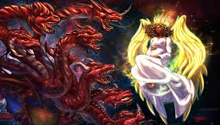
Notes:
Israel Jesus and Woman v Seven Headed Dragon Revelation 12 is a painting by The Decree to Restore Jerusalem which was uploaded on July 25th, 2015.

Slide 19
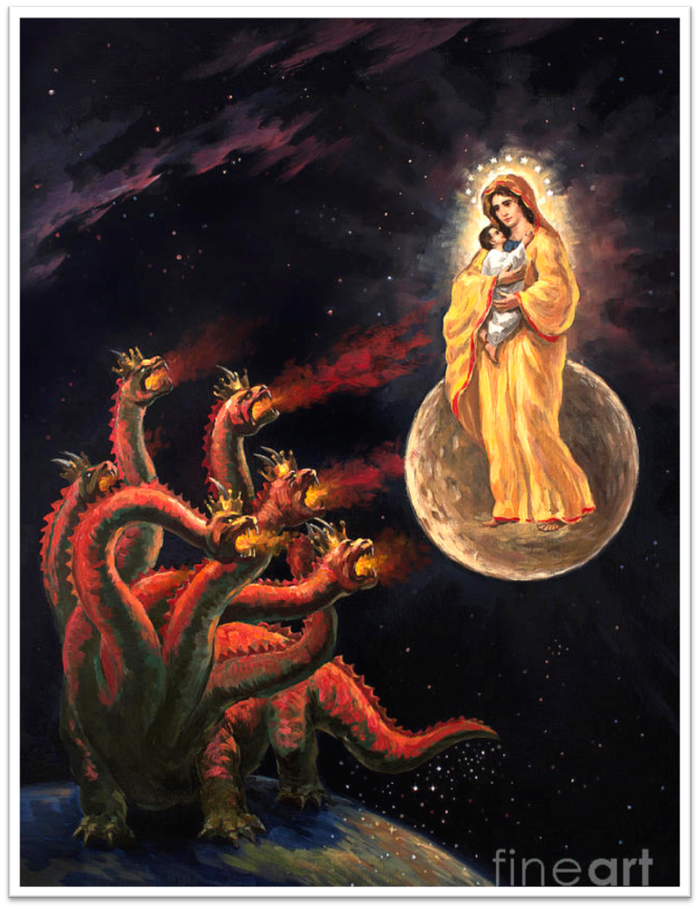
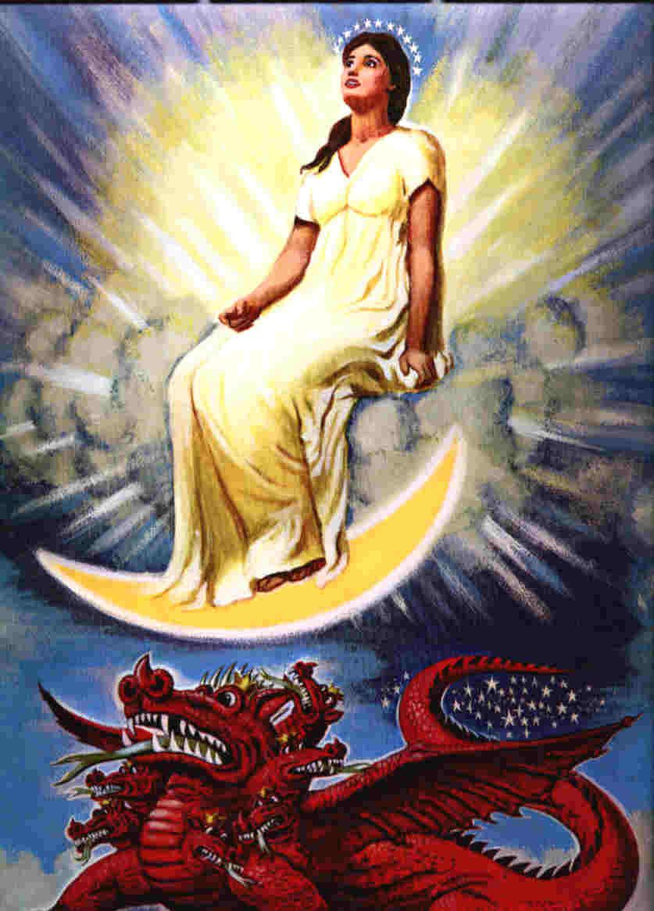

Slide 20
Revelation 12:5-6 The Male Child
5 And she gave birth to a son, a male child, who is to rule all the nations with a rod of iron; and her child was caught up to God and to His throne. 6 Then the woman fled into the wilderness where she *had a place prepared by God, so that there she would be nourished for one thousand two hundred and sixty days.
Notes:
Jesus is the One who is prophesied to “strike the nations. And He Himself will rule them with a rod of iron” (Revelation 19:15).
The verse continues, “And her Child was caught up to God and His throne.” = the Ascension!
Fled into the wilderness = Jesus to Egypt as baby?... Wilderness temptations?...
Nourished!! = a lot we don’t know... But God takes care of those who belong to Him!!!
1260 days = 1260 years?? 3-1/2 years?? A brief amount of time—half of seven?? (half of last week of Daniel’s prophesy?)

Slide 21
Revelation 12:7-9 War in Heaven
7 And there was war in heaven, Michael and his angels waging war with the dragon. The dragon and his angels waged war, 8 and they were not strong enough, and there was no longer a place found for them in heaven. 9 And the great dragon was thrown down, the serpent of old who is called the devil and Satan, who deceives the whole world; he was thrown down to the earth, and his angels were thrown down with him..
Notes:
War in heaven = When???
In Heaven or in the heavenly realm?
Michael = guardian archangel of Israel !! But the daily victory is described in vs 11 overcame by the blood of the lamb and word of their testimony to death!!!
Thrown down = the good guys win !!!
Isaiah 14:12–15 English Standard Version
12 “How you are fallen from heaven, O Day Star, son of Dawn!
How you are cut down to the ground, you who laid the nations low!
13 You said in your heart, I will ascend to heaven; above the stars of God
I will set my throne on high; I will sit on the mount of assembly in the far reaches of the north;
14 I will ascend above the heights of the clouds; I will make myself like the Most High.’
15 But you are brought down to Sheol, to the far reaches of the pit.
Vs 9-10 Names for Satan
The great dragon...
The serpent of old... Old = ἀρχαῖος = ancient
The devil (Διάβολος = "to slander, accuse, defame") – properly, a slanderer; a false accuser; unjustly criticizing to hurt (malign) and condemn to sever a relationship.) ...
Satan (Σατανᾶς = the adversary)
Who deceives the whole world = πλανῶν lead astray, deceive, cause to wander.
Vs. 10 the accuser of our brethren has been thrown down, he who accuses them before our God day and night. = κατήγωρ : an accuser, prosecutor.

Slide 22
Revelation 12:9-10 Names of Satan
9 And the great dragon was thrown down, the serpent of old who is called the devil and Satan, who deceives the whole world; he was thrown down to the earth, and his angels were thrown down with him.. 10 ... for the accuser of our brethren has been thrown down, he who accuses them before our God day and night.
Notes:
Vs 9-10 Names for Satan = reveals his character and schemes
The great dragon... Universal symbol of evil
The serpent of old... Old = ἀρχαῖος = ancient = the trickster from the Garden of Eden
The devil (Διάβολος = "to slander, accuse, defame") – properly, a slanderer; a false accuser; unjustly criticizing to hurt (malign) and condemn to sever a relationship.) ...
Satan (Σατανᾶς = the adversary) enemy
Who deceives the whole world = πλανῶν lead astray, deceive, cause to wander.
Vs. 10 the accuser of our brethren has been thrown down, he who accuses them before our God day and night. = κατήγωρ : an accuser, prosecutor.
Tricks:
Slander = FALSE accusations against you and others
Accusation = TRUE accusations...
against you... Downward spiral of guilt
Against others... Keeps you separated and fighting one another instead of recognizing his schemes
Deception =
The father of lies... He’s good at it. His native language.
Fighting flesh instead of him
Ephesians 6:10ff the Full Armor of God 10 Finally, be strong in the Lord and in the strength of His might. 11 Put on the full armor of God, so that you will be able to stand firm against the schemes of the devil. 12 For our struggle is not against flesh and blood, but against the rulers, against the powers, against the world forces of this darkness, against the spiritual forces of wickedness in the heavenly places. 13 Therefore, take up the full armor of God, so that you will be able to resist in the evil day, and having done everything, to stand firm. 14 Stand firm therefore, having girded your loins with truth, and having put on the breastplate of righteousness, 15 and having shod your feet with the preparation of the gospel of peace; 16 in addition to all, taking up the shield of faith with which you will be able to extinguish all the flaming arrows of the evil one. 17 And take the helmet of salvation, and the sword of the Spirit, which is the word of God.

Slide 23
END HERE SEPTEMBER 9, 2020
WEEK 17 Revelation 12
BEGIN HERE SEPTEMBER 16, 2020
WEEK 18

